Slide 1


BASIC DETAILS OF THE TEAM
Manual lead conversion and sales team causing financial burden and difficulty to manage for new or small business
Problem Statement Title :
CodeHamsters
Team Name :
MARKETEASE
Aakarshan
Team Leader Name :
Theme : AIML
Student Innovation
Track :
GL BAJAJ GROUP OF INSTITUTIONS, MATHURA

Slide 2
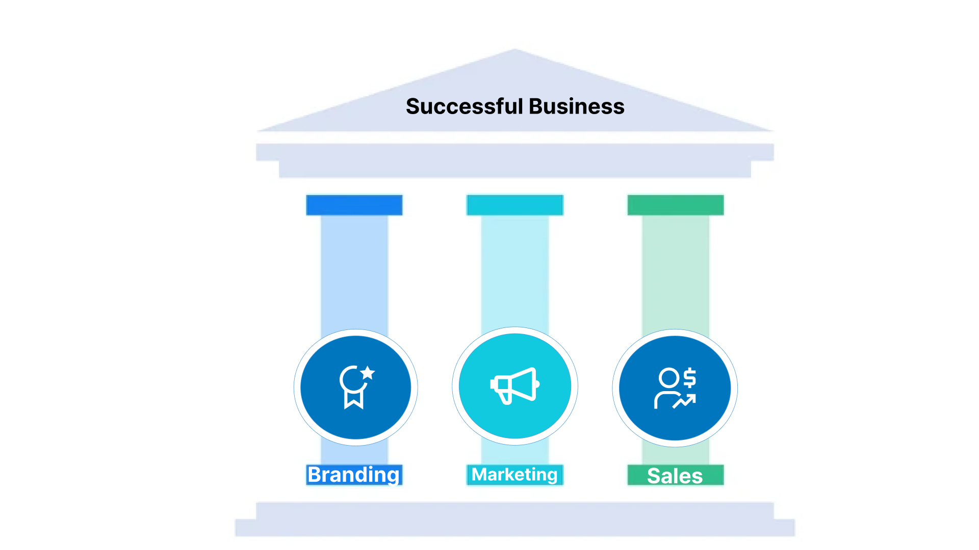
CodeHamsters

Slide 3
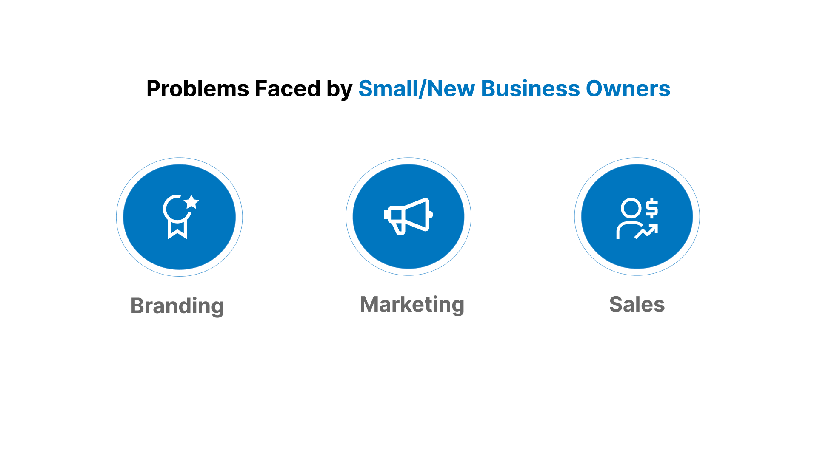
CodeHamsters

Slide 4
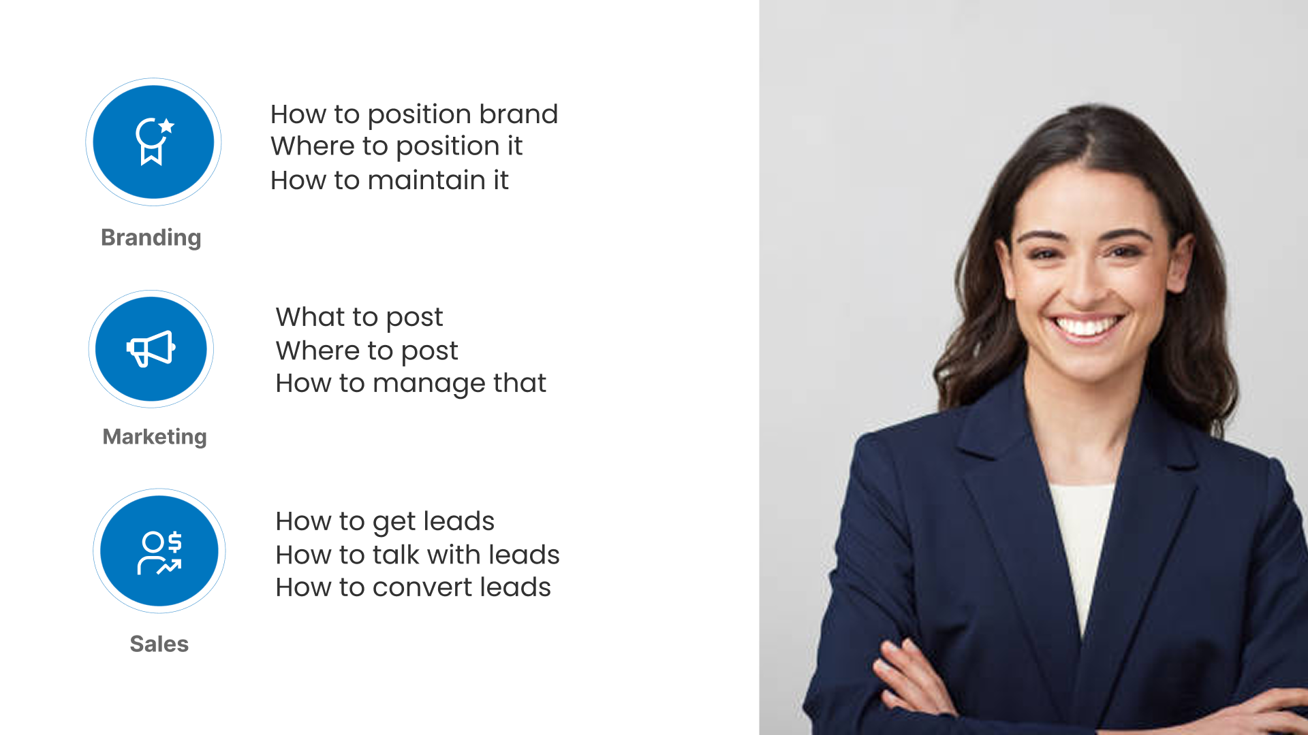
CodeHamsters

Slide 5
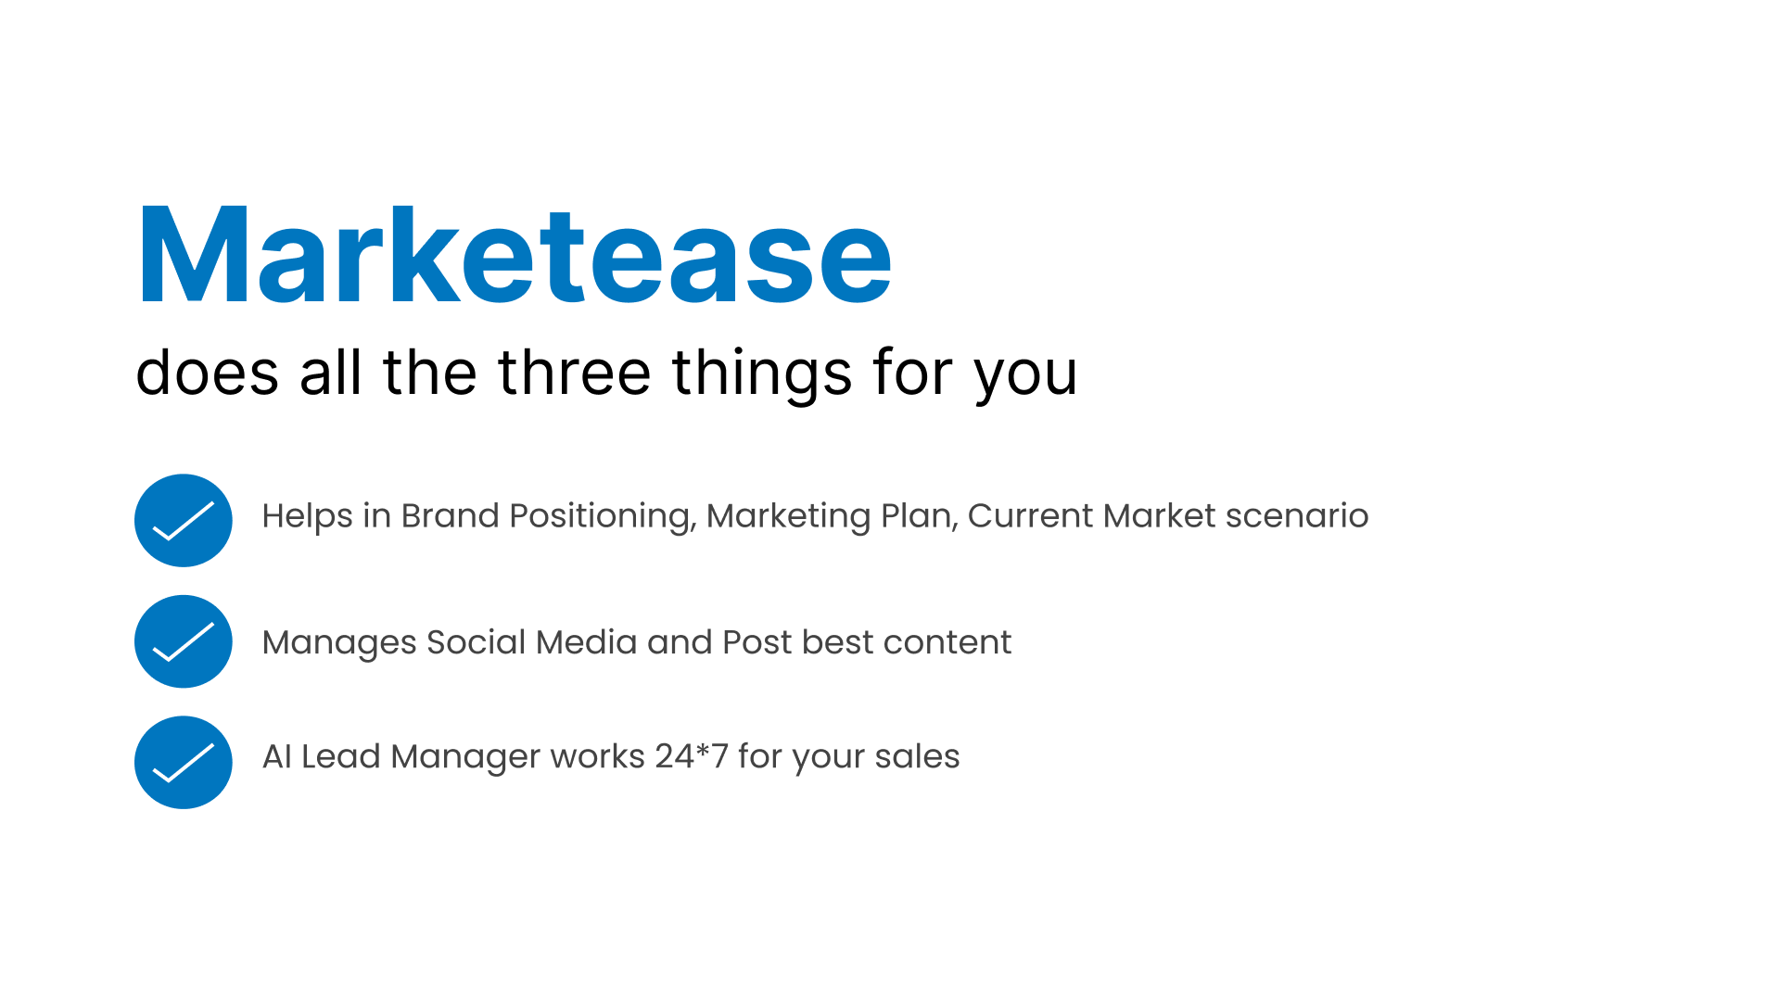
CodeHamsters

Slide 6

CodeHamsters
Market Ease - AI Powered Marketing Assistant
Problem
Small businesses & startups struggle to manage marketing while focusing on core business.
Our Solution – Market Ease
A smart AI assistant that automates social media, lead management, and scheduling.
Why it’s unique
Combines AI + Automation + Personalization in one compact solution.
Hiring digital marketing agencies costs ₹30k–₹40k/month – not affordable for most SMBs.
DIY marketing is time-consuming, needs domain expertise, and lacks consistency.
Manual processes = inefficient, error-prone, and hard to scale.
Designed specifically for small businesses that can't afford full-time marketing teams.
Handles end-to-end marketing: content suggestions, post scheduling, performance tracking, and lead follow-ups – all on autopilot!
Integrated with WhatsApp – businesses can operate everything from their phone!
Cost-effective, easy-to-use, and tailored for non-tech-savvy users.
Works like a virtual marketing team that's always active, never tired

Slide 7
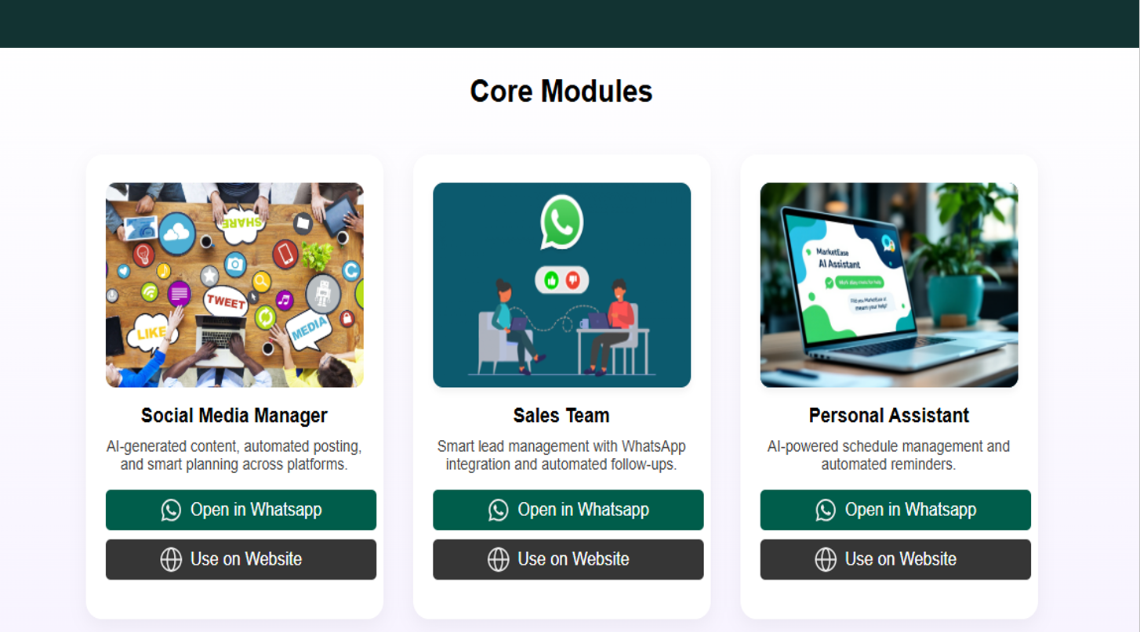

Slide 8
CodeHamsters
TECHNICAL
REQUIREMENTS
Frontend: HTML, CSS Javascript -clean UI for Dashboard Access
Database: MYSQL(for structure data) & MongoDB(for unstructured data e.g call logs)
AI/ML: Tensorflow for NPL tasks like: Content recommendation, Lead Scoring & Auto – response
API’s & Integration: Whatsapp API(via Twilio or Meta) Instagram/Facebook Graph API for social media posting
Backend: Python(for AI Logic), Node JS(for API’s & real time communication.

Slide 9
CodeHamsters
IMPACT & BENEFITS
Impact
Enables small businesses to compete online, even with zero marketing experience
Key Benefit
Affordable Marketing: 1. Cuts down Marketing expenses. 2. Ideal for SBMs, solopreneurs, & Tier 2/3 businesses
Scalability & Consistency: 1. Ai ensures round the clock performance. 2. Content & responses improve over time using real- time feedback
Time Efficiency: 1. Automates daily posting, replies, & reminders. 2. Saves atleast 10-15 hours/week in manual effort
Empowerment over Dependency: 1. Businesses no longer rely on agencies or freelancers
Bridges the digital gap for non-tech-savvy entrepreneurs across Tier 2/3 cities
Turns everyday smartphones into powerful marketing hubs via WhatsApp automation
Reduces business failure risk by helping local brands build visibility & customer loyalty
Empowers solopreneurs (e.g., tutors, designers, home chefs) to automate client outreach and grow without extra hires

Slide 10
CodeHamsters
RESEARCH & REFERENCES
•Market Report: https://www.mckinsey.com/capabilities/growth-marketing-and-sales/our-insights/sales-automation-the-key-to-boosting-revenue-and-reducing-costs#/
Mistral AI function calling feature: https://docs.mistral.ai/capabilities/function_calling/

